Slide 1


Final Dissertation
BACHELOR’s DEGREE in COMPUTER SCIENCE
a web graphical user interface for the
packet-loss-concealment testbench tool
Student Stefano Dallona | Supervisor Prof. Luca Turchet | Co-Supervisor Ing. Luca Vignati
Notes:
Good afternoon to everyone, first of all I would like to thank all the committee members for attending the discussion of my thesis work.
My name is Stefano Dallona, I'm a student of the Bachelor's Degree in Computer Science and for the entire duration of my studies I’ve worked full-time.
The title of my thesis is: "A Web Graphical User Interface for the Packet-Loss-Concealment Testbench Tool".
My work was supervised by professor Turchet and by Luca Vignati.
What really attracted me about this thesis was the immediate applicability and the fact that the topic was completely new to me.

Slide 2

Introduction
1
Context
PLC Testbench, a tool to compare Packet Loss Concealing algorithms
2
Problems
Interaction only possible at code level in an IDE
Output information not integrated
3
Solution
Development of a graphical user interface
Notes:
The context in which this thesis was born is the PLC Testbench, a tool to compare Packet-Loss-Concealment algorithms developed by Luca Vignati.
PLC algorithms try reconstruct the lost portions of audio streams to provide acceptable quality on lossy connections.
The biggest problems with the PLC Testbench were that:
the interaction with the tool was possible only at code level;
the output information was not integrated, making the analysis inefficient
The development of a Graphical User Interface was seen as a solution to these problems.

Slide 3

Purpose of the Thesis
Developing a GUI for the PLC Testbench tool
to boost up
QUALITATIVE and QUANTITATIVE
comparison of PLC algorithms
by making the INTERACTION with the tool
EASY, EFFECTIVE and EFFICIENT
Notes:
The purpose of this thesis work was therefore developing a GUI for the PLC Testbench to boost up the qualitative and quantitative comparison of PLC algorithms by making the interaction with the tool easy, effective, and efficient.
Qualitative comparison mainly consists in visually comparing waveforms and spectrograms, and in listening to audio files.
Quantitative comparison is essentially based on metrics calculated the reconstructed audio files.

Slide 4
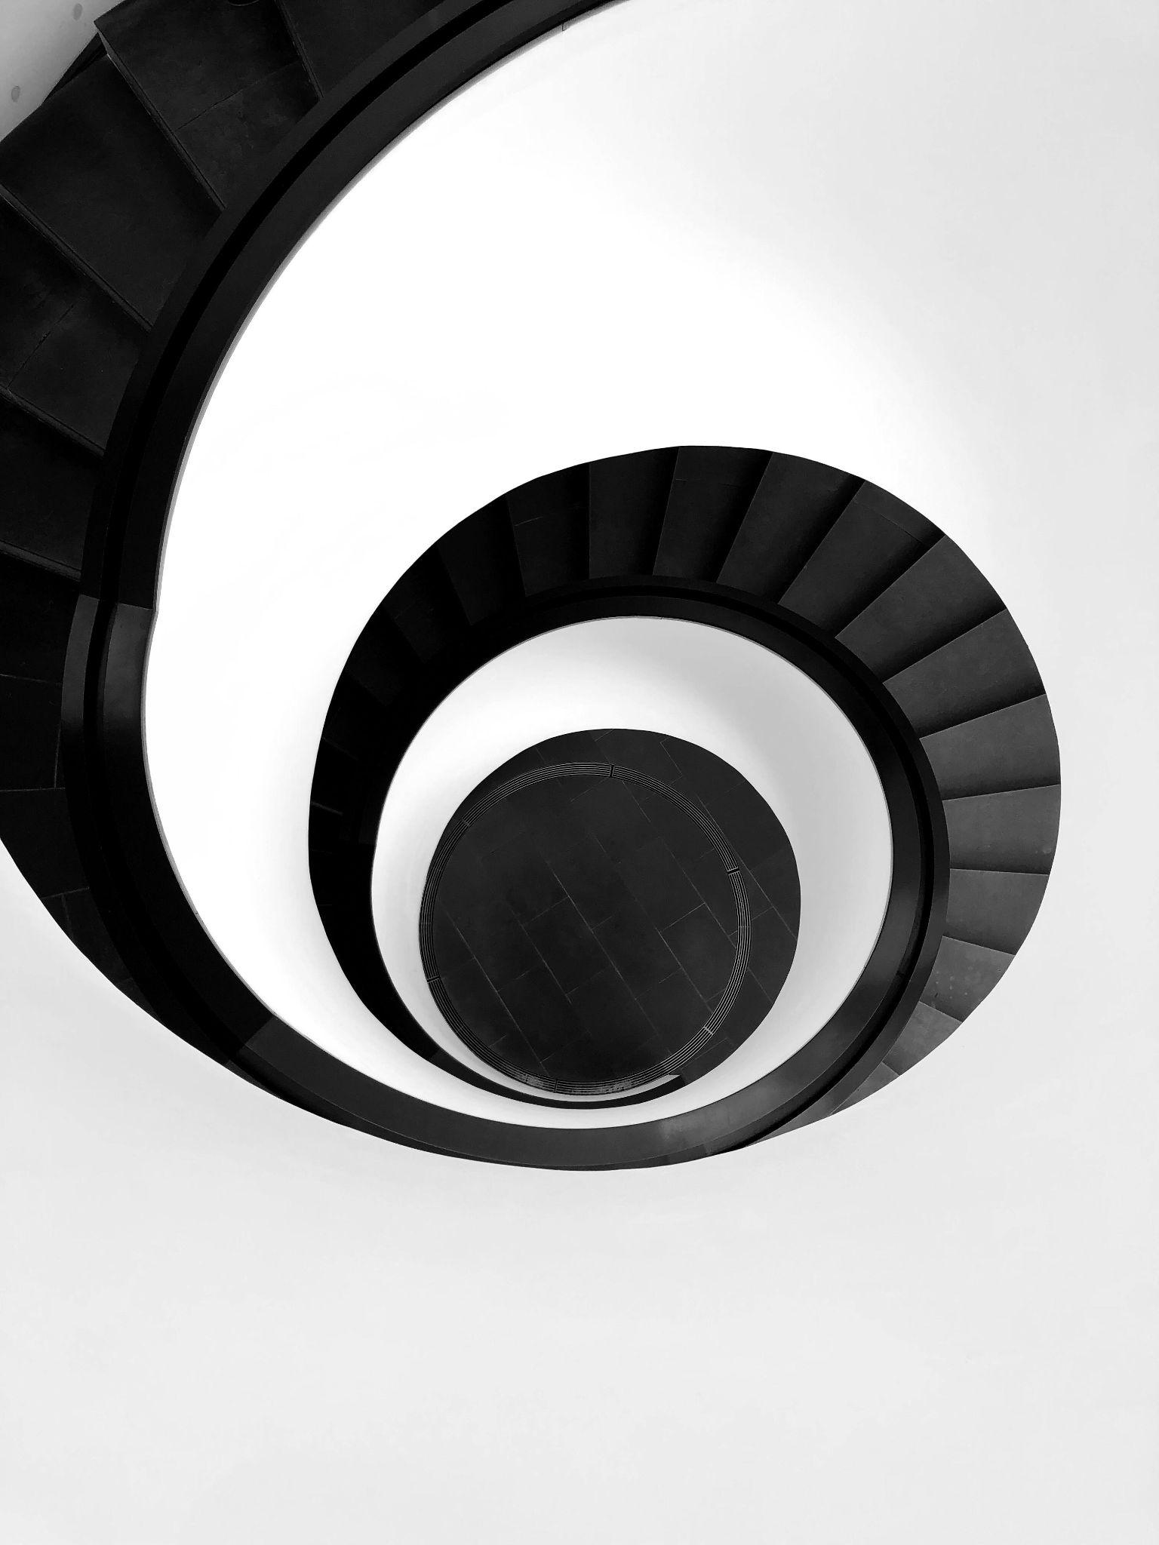
Methodology
Iterative agile development process
short release cycles
focus
fast feedback
< risk of useless development
1
2
N
Design
Design
Design
…
Testing
Develop
Testing
Develop
Testing
Develop
Notes:
From a methodological perspective, it was decided to adopt an iterative agile development process composed of short cycles of design, develop and testing phases.
This helped keeping the focus on small and clear objectives and getting fast feedback, thus minimizing the risk of developing useless functions.

Slide 5





Technologies
Front-end Javascript + React | Back-end Python + Flask | Packaging & Distribution Docker | Build & Deploy Circle CI pipelines
Notes:
The GUI was developed through a Web application, made of two layers: a frontend, implementing the graphical part of the UI, written in JavaScript and based on React framework and a backend, implementing services over a REST API, written in Python and based on Flask framework.
Bundling and distribution were addressed by containerizing the application as a Docker image, while for build and deploy I leveraged Circle CI’s pipelines as code.

Slide 6
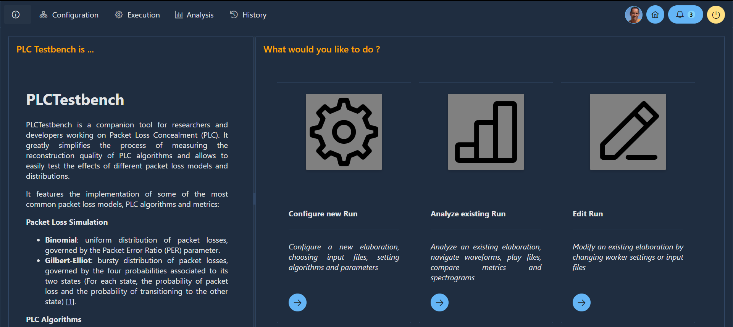
GUI - Landing Page
Notes:
Now time has come to have a look at the application interface.
This is the landing page which addresses two main purposes:
helping the user to develop a proper mental model of the software by providing on the left a short help page;
putting the user in condition to start using the tool immediately by displaying on the right a list of the most relevant operations supported by the application, with a direct entry point to the functions.

Slide 7
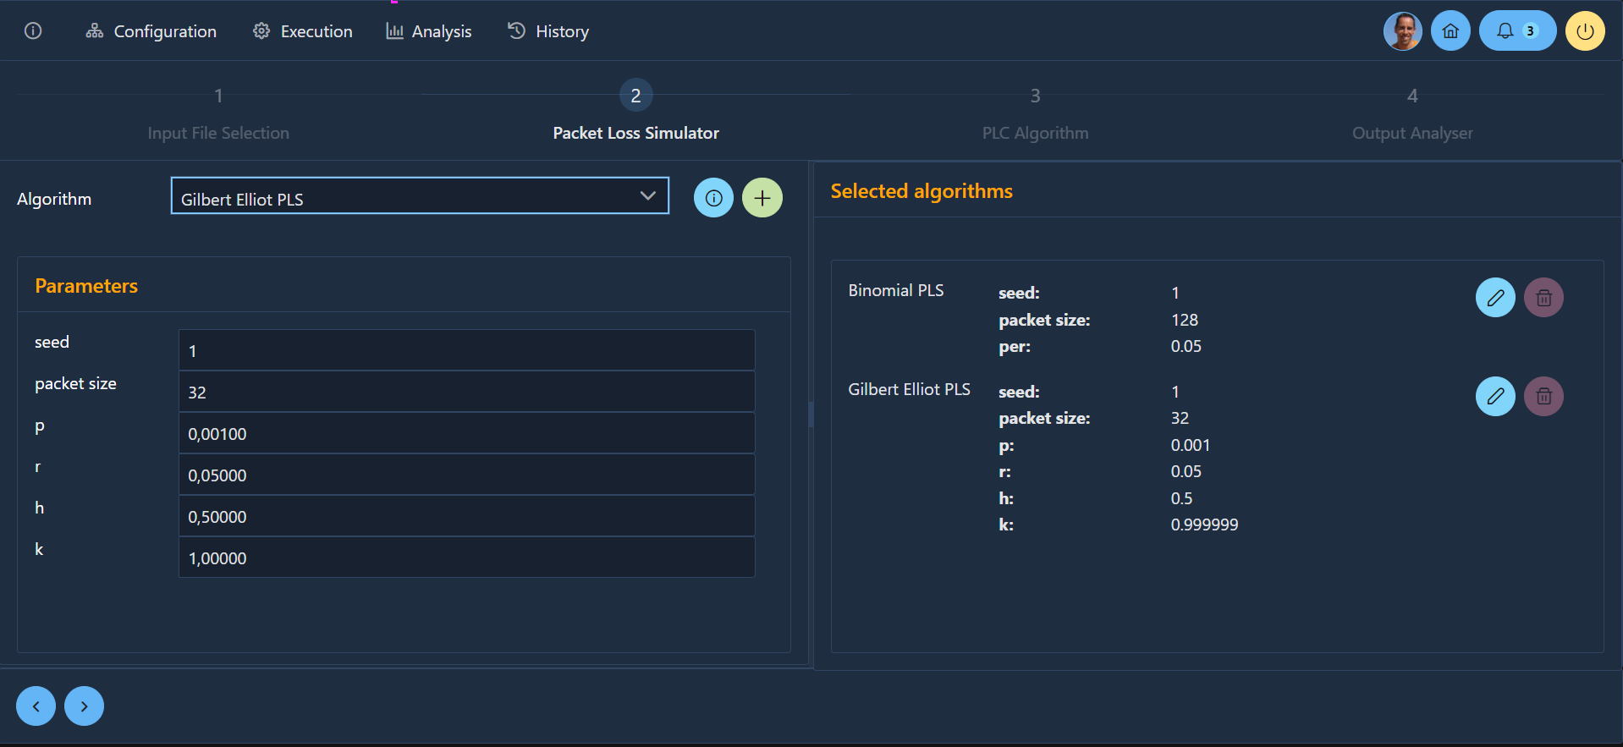
GUI - Configuration Module
Notes:
This screen instead is intended to guide the user through the configuration of an elaboration focusing on three objectives:
fast and effective interaction: pursued with sensibile defaults for the settings and keyboard shortcuts;
clarity: pursued by splitting the configuration process into multiple sequential steps;
adaptability: achieved by implementing dynamic discovery of the algorithms and settings, thus supporting testbench extensions with no changes to the code.

Slide 8
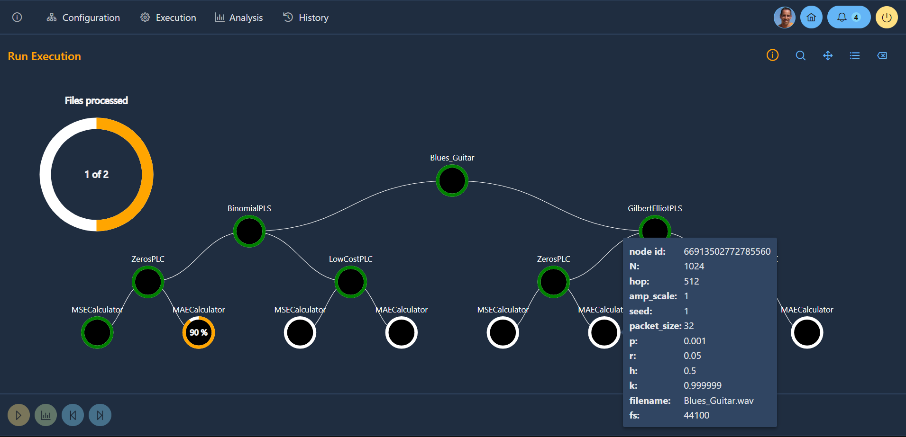
GUI - Execution Module
Notes:
A PLC Testbench elaboration can be represented as a forest of trees, each corresponding to a single input file. Processing can take a long time, thus progress monitoring is essential.
Since the structure identical for all the input files it was decided to display progress at two different levels of detail: overall progress and progress within a single file processing. The settings of each elaboration step can be inspected by placing the mouse pointer over the corresponding node.

Slide 9
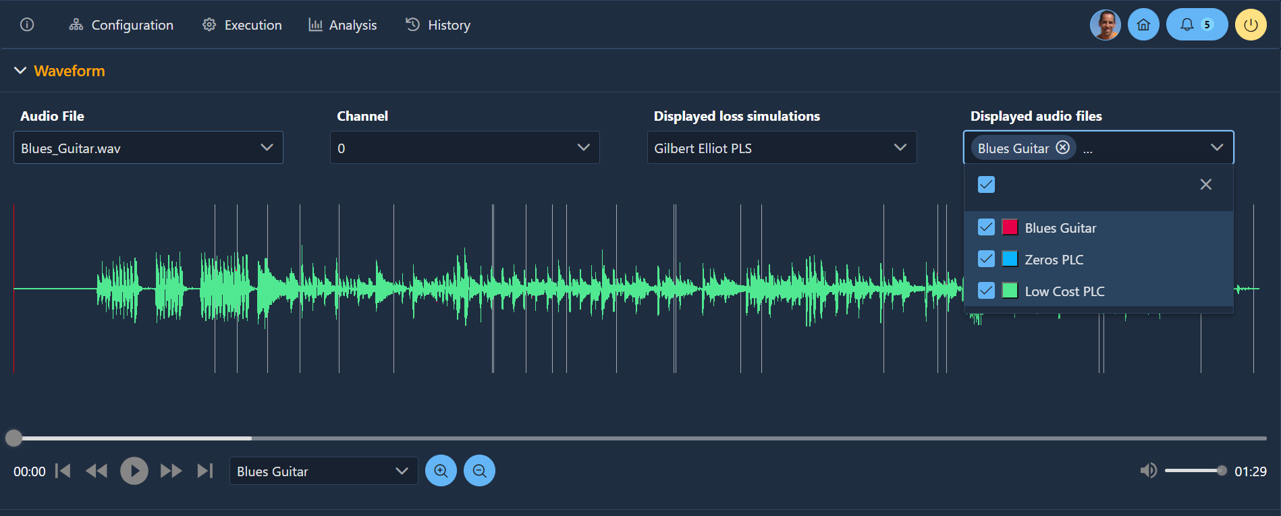
GUI - Analysis Module - 1
Notes:
In the analysis module the waveforms of all the versions of a given input file are displayed on the same chart, together with the lost packets’ regions.
Each waveform can be shown or hidden independently.
Each version of the audio file can be played to evaluate the perceived quality of the reconstruction.
Zoom-in function supports any level of detail.

Slide 10
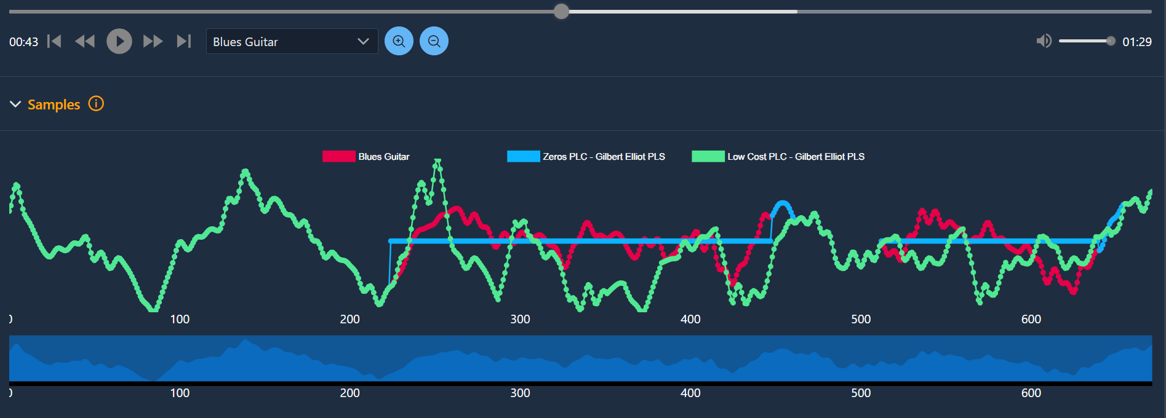
GUI - Analysis Module - 2
Notes:
In the “Samples” view in the analysis module at the maximum zoom level single audio signal’s samples can be discriminated. Zoom-in and zoom-out are supported by dragging the handles in the bar below the chart. Each waveform can be shown or hidden independently.
The more the original and the reconstructed signals overlap, the more the reconstruction can be considered accurate.

Slide 11
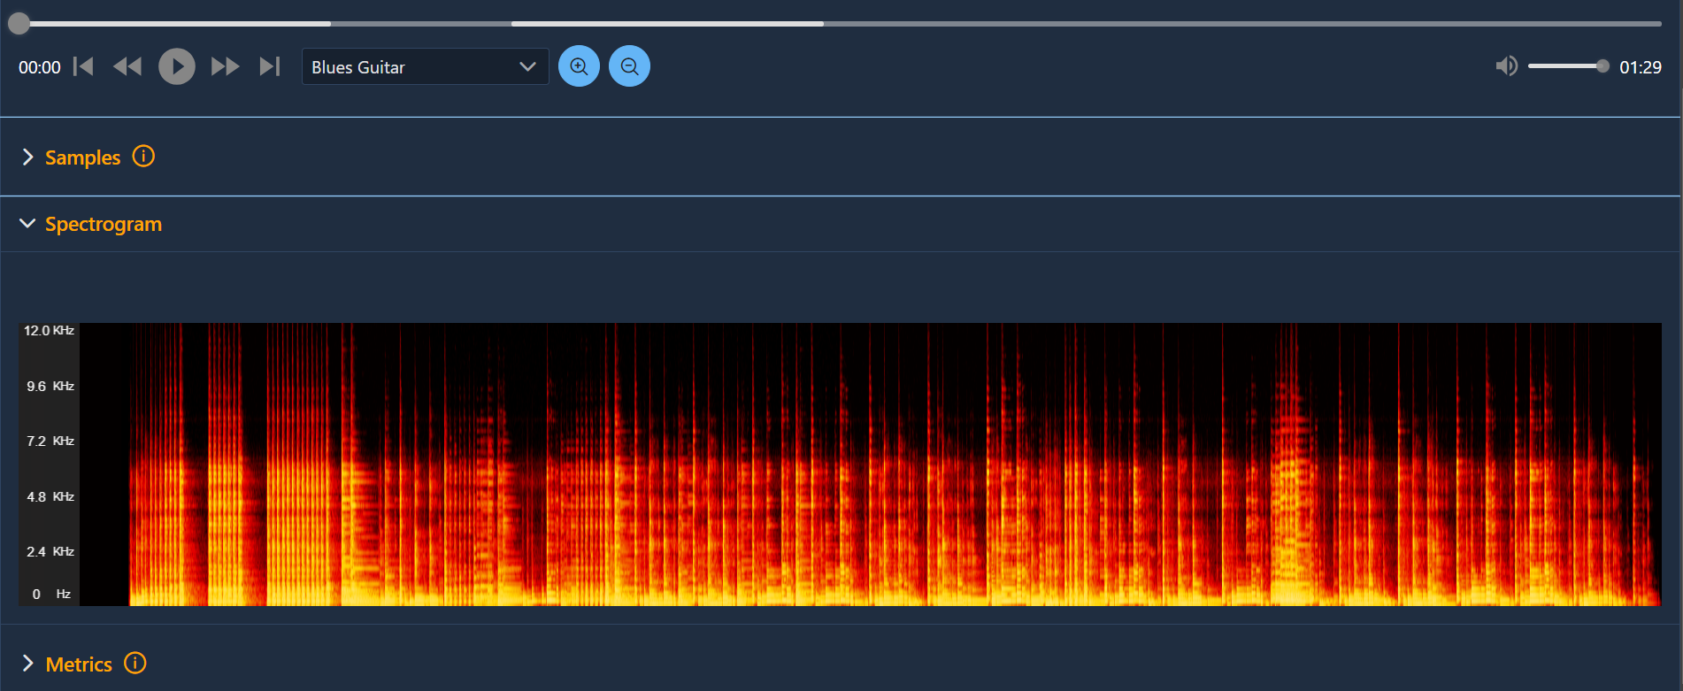
GUI - Analysis Module - 3
Notes:
For each audio file a spectrograms can be displayed, representing the composition of the audio signal over time as a color map, where brighter colors indicate a greater intensity of the corresponding frequencies.

Slide 12
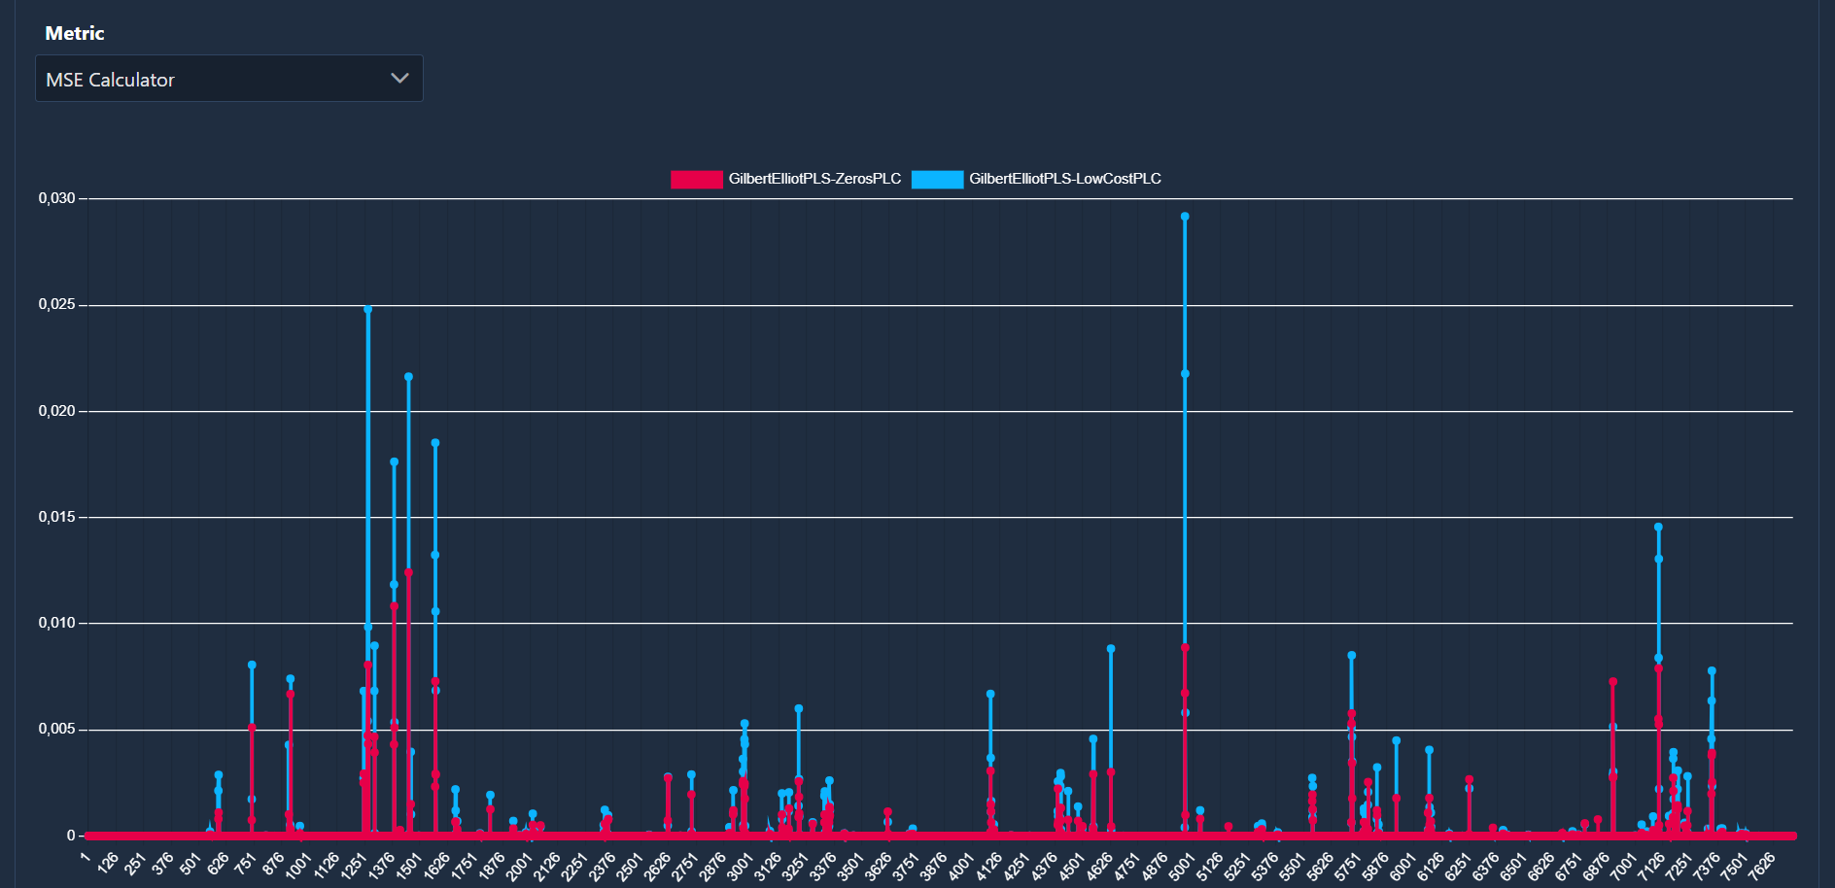
GUI - Analysis Module - 4
Notes:
Output metrics are calculated on each original and reconstructed audio file. They can be grouped into two categories: linear metrics, producing a time series for each audio file, and scalar metrics, producing a single value for each audio file.
The data to be displayed can be customized by clicking on the legend items.

Slide 13
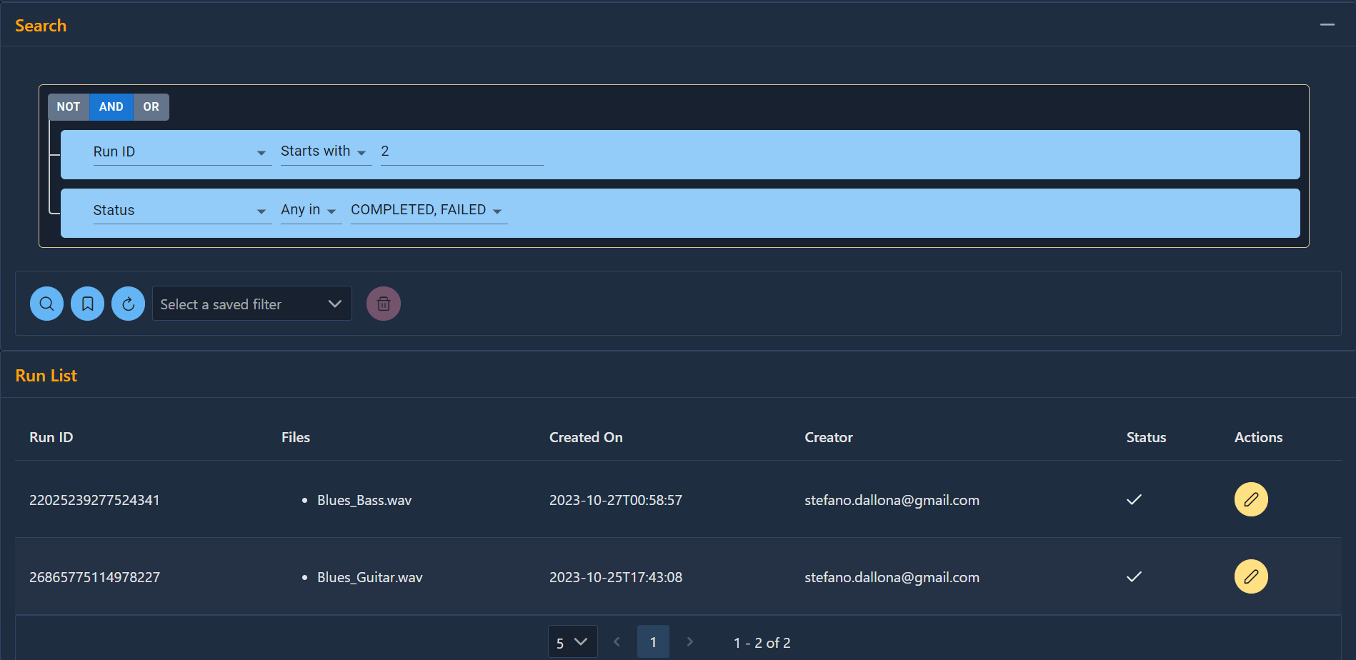
GUI - Search Module
Notes:
The search module allows the user to navigate through the list of the elaborations or to build, save and re-execute specific queries.
Queries can be built visually by combining multiple conditions using logical operators.
Each condition can be based on any field of the elaboration or on any setting of the referenced algorithms.

Slide 14
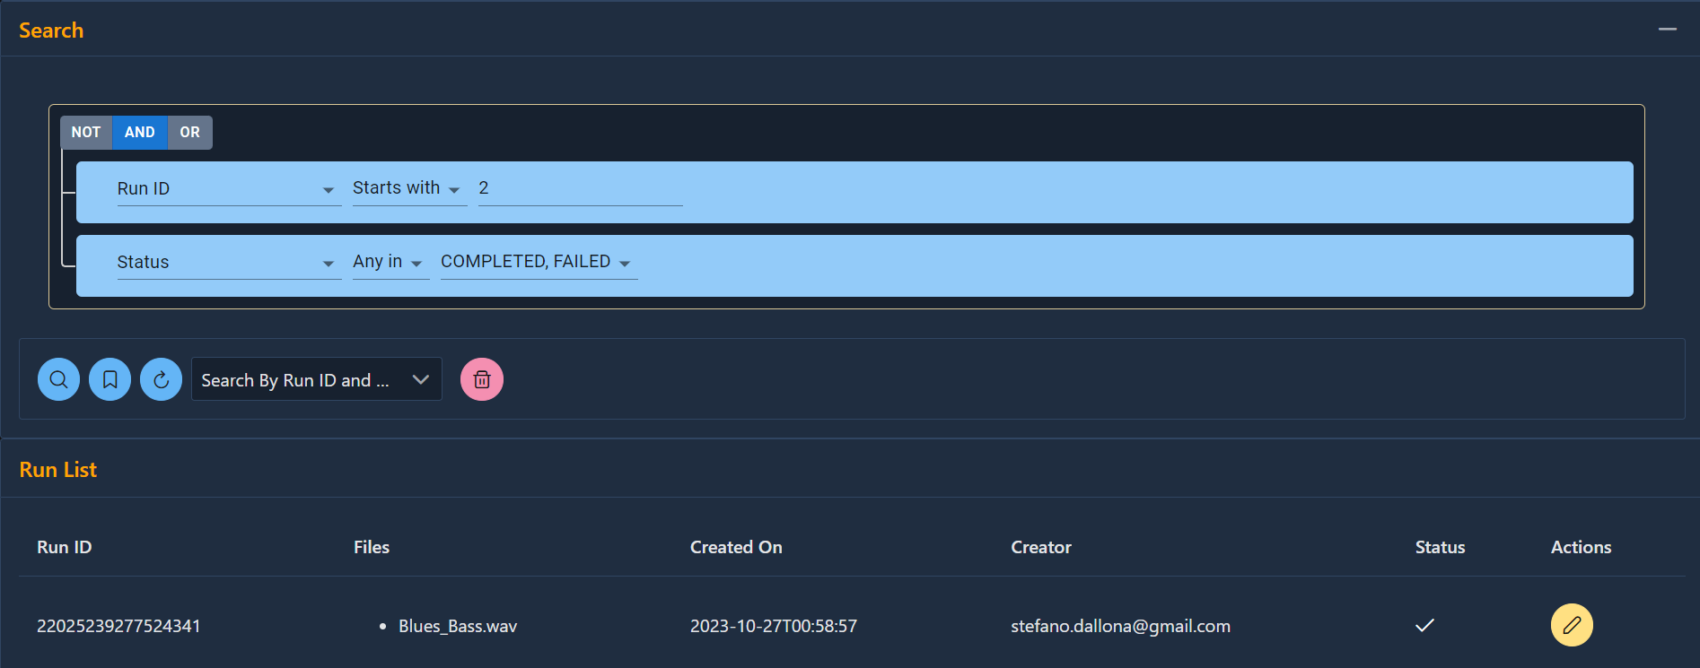
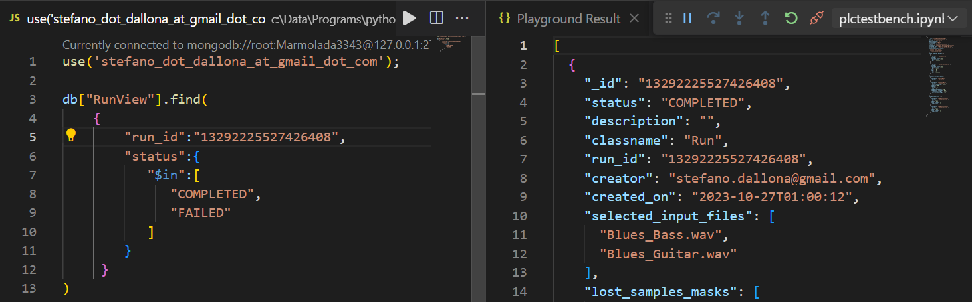
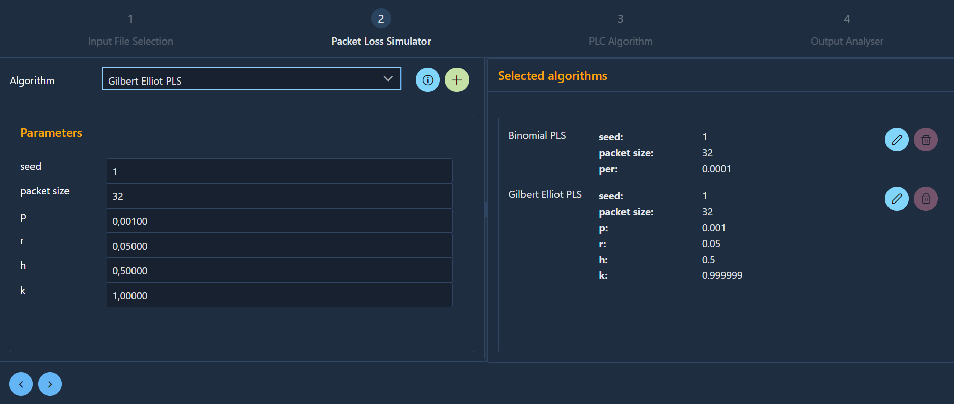
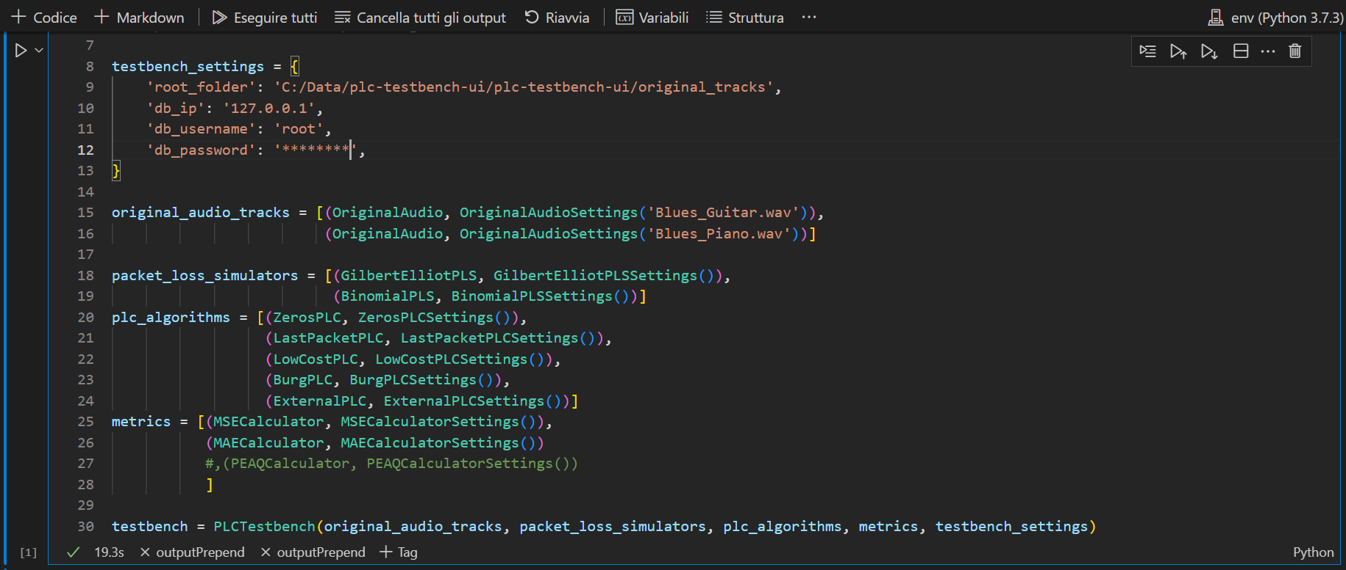
GUI vs Native Interaction - 1
Notes:
This slide shows a visual comparison of how elaborations inquiry and configuration are performed in the web GUI versus how they are carried out through the native testbench interface.
On the left in the GUI supports the interaction is completely visual while on the right, in the native mode, the same operations have to be performed at programming level.

Slide 15
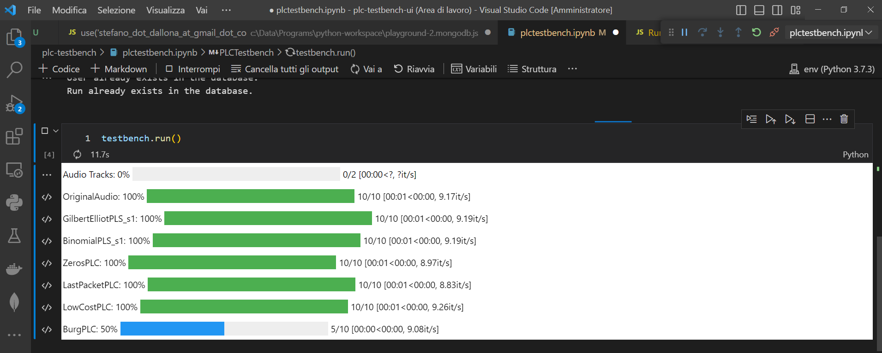
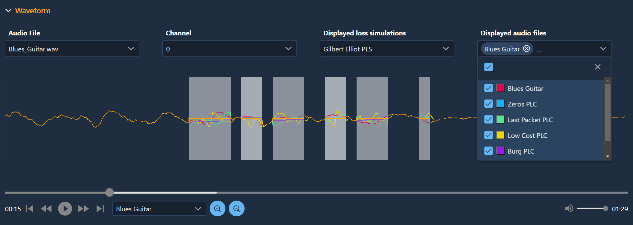
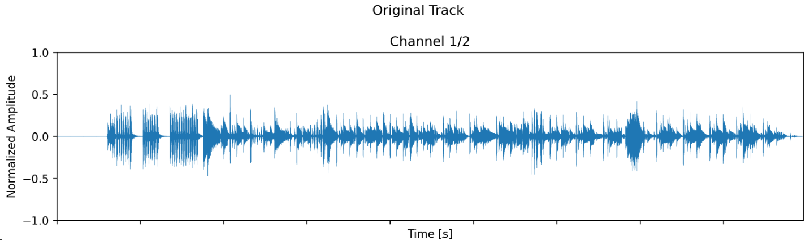
GUI vs Native Interaction - 2
Notes:
Here the same comparison Is applied to the progress monitoring and results analysis use cases.
Also in this case the web GUI provides a more convenient and effective interaction by presenting output information in a more detailed and integrated way.

Slide 16

Results
Benefits brought to the PLC Testbench tool
Easier installation
Debug & validation
Scalability
Improved analysis
capability
Usage extension
Notes:
The most relevant benefits brought to the PLC Testbench tool by this thesis work can be summarized as follows:
a thorough debug and validation of the testbench was carried out during of the project;
the analysis capabilities of the tool have been extended and improved in terms of quantity and quality of the information;
tool installation has been made easier by encapsulating the complexity in the build process of the docker image;
the application has been made more scalable by making distributed deployment possible;
the possibility to use the tool has been extended to users with no expertise in Python programming.

Slide 17

Future Work
A few ideas
Extensive validation with users (*)
Support for additionals audio formats
Search functions on output results
User collaboration use cases
Data export
(*)
A first preliminary but very positive feedback has been received from experts at the IS2 2023 Conference in Pisa
Notes:
Despite being fully operational and exposing all the current functions of the underlying PLC Testbench, the web GUI still has a lot of room for improvement.
A few ideas for possible future enhancements are:
Extensive validation with users;
Support for additionals audio formats;
Search functions on output results;
User collaboration use cases;
Data export.

Slide 18




References
 | GitHub repository of the project https://github.com/cimil/plc-testbench public access
 | Docker image of the project https://hub.docker.com/r/cimil/plc-testbench-ui public access
 | Paper presented at the IS2 2023 in Pisa 4th International Symposium on the Internet of Sounds https://drive.google.com/file/d/1kFY9Hj-G7mWJP7U3CpPZf9TR95M5tQGV/view?usp=drive_link restricted access
Notes:
The results of this thesis work are publicly available in the form of source code at the GitHub URL mentioned in the slide or as a pre-built docker image at the indicated DockerHub URL.
A paper about the jointed work of Luca Vignati and me for the respective thesis was presented at the 4th International Symposium on the Internet of Sounds, held in Pisa on the 26-27th of October 2023 and will soon be available in the proceedings of the conference.

Slide 19

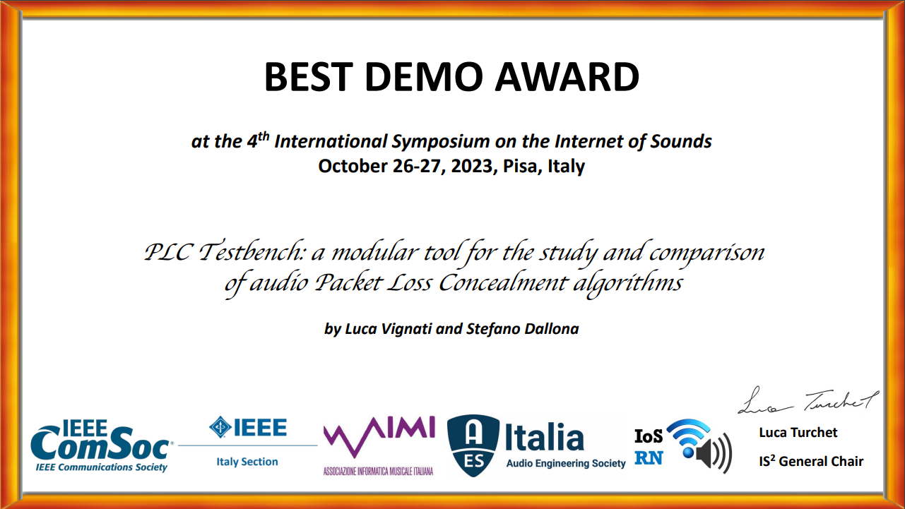
Prizes
Notes:
During the conference in Pisa the software was presented to a team of experts and got a very positive feedback.
At the end of the conference Vignati and me had the great honor to be prized with the “Best Demo Award”.
Thank you so much for your attention.
Now I am at your disposal in case there are any questions.

Slide 20

Conclusions
PLC Testbench
Native interaction
Web GUI
- limited and raw visual output
- no output integration
- programming-level interaction
- installation complexity
- sophisticated visual output
- highly integrated output
- graphical interaction
- installation ease
Notes:
Finally this slide summarizes the major achievements of this thesis work by highlighting the most critical limitations of the native PLC Testbench's interface and how they were addressed and overcome in the web GUI.
For example:
limited and raw output has been replaced by a sophisticated dashboard where information is highly integrated;
interaction mode has been turned from programming level into graphical;
installation complexity has been completely hidden.

Slide 21

Acknowledgements
Thanks to
Prof. Luca Turchet
Ing. Luca Vignati
for the invaluable feedback
and support provided

